Slide 1

P2 project Bag Packer Program
Made by:
Christian J. O’Keeffe
Rasmus F. Gadensgaard
Aleksander S. Nilsson
Kasper Plejdrup
Dag T. B. Pedersen
Mette T. Pedersen
Niels B. Pedersen

Slide 2
Content of presentation
Problem Analysis
Theory
Design
Development
Testing
Discussion & Conclusion
Process Analysis

Slide 3
Initializing problem
People can’t pack a suitcase properly

Slide 4
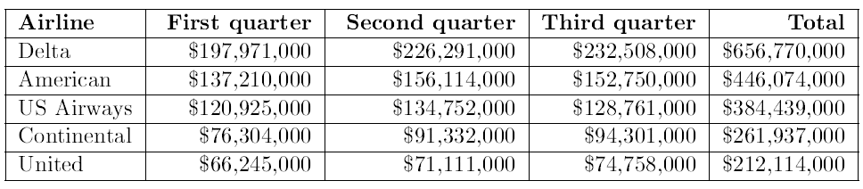
Documentation of problem
People get fees for having overweight in their suitcases

Slide 5
Solutions on the Market
Product:
App - Packing Pro
Online check/tip list
The e-Commerce shipping calculator
Purpose of looking at existing solutions

Slide 6
Problem Statement
“How can a program be developed which helps the customer through the process of packing one or more suitcases the most effective way by size and weight?”
Substatements

Slide 7
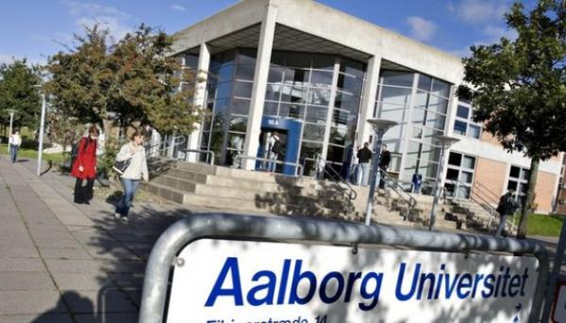
Method
Work by the Aalborg PBL model.
Source criticism

Slide 8


Bin Packing Problem
What is the bin packing problem?
Example of bin packing in 1D
Knapsack Problem

Slide 9
Specication Requirements
Targeted Features
Guide the User
Distribute Weight
Distribute Space
On the Road
Baggage Rules
Structure of Packing
Packing list
Save/Load function

Slide 10
Solution suggestions
Application for smartphones
Extension for an existing program
Program for the computer
Choice of solution

Slide 11

Demonstration of program

Slide 12
Different function description
The packing algorithm
Color assignment function
How the program handles 3D
Function to draw cubes

Slide 13
Packing Algorithm
Goal of packing algorithm
SPØRG KARSTEN OM Flowchart

Slide 14
Color Assignment Function

Slide 15
How the program handles 3D

Slide 16
Testing
Choice of Survey Method
The First Round of Tests
The Second Round of Tests
Conclusion
Unit Tests

Slide 17
Discussion
Discussion
Perspectivation

Slide 18
Conclusion

Slide 19
Process Analysis
Project planning
Group Work
Collaboration with Supervisors
Process of Learning
Discussion and Putting Things into Perspective
Conclusion

